Slide 1

Towards a multi-process model of antisaccades in PD
Jen Lewis

Slide 2
Towards a multi-process model of antisaccades in PD
Outline
Part I: The antisaccade task and Parkinson’s disease
Part II: The basal ganglia and the antisaccade network
Part III: Existing basal ganglia model of antisaccades
Part IV: A novel approach to modelling antisaccades in PD
Part V: Exciting model results!

Slide 3
Towards a multi-process model of antisaccades in PD
Part I: The antisaccade task and Parkinson’s Disease

Slide 4
Towards a multi-process model of antisaccades in PD
The prosaccade and antisaccade tasks
Prosaccade
Antisaccade
Time

Slide 5
Towards a multi-process model of antisaccades in PD
Typical findings:
Healthy controls
Common to make ~10-20% errors (prosaccades) on antisaccade task
Antisaccades slower by around 50-200ms
RTs and error rates vary according to paradigm and task features
Parkinson’s disease
Higher error rates than age-matched controls (up to 70%)
Antisaccades slower still
Prosaccades not similarly affected – some evidence actually faster
Effects worse with increasing PD severity?

Slide 6
Towards a multi-process model of antisaccades in PD
Typical findings:
From data in Kitagawa et al., 1994
Error rates (%)
Saccade latencies (ms)
Trends consistent across studies even where results non-significant

Slide 7
Towards a multi-process model of antisaccades in PD
Pattern holds for recent data from Oxford ‘Discovery’ study:
Saccade latencies (ms)

Slide 8
Towards a multi-process model of antisaccades in PD
Error prosaccades are faster than antisaccades
(…but often slower + noisier than prosaccades)
Saccade latencies (median: ms)
From data in Walton et al., 2015

Slide 9
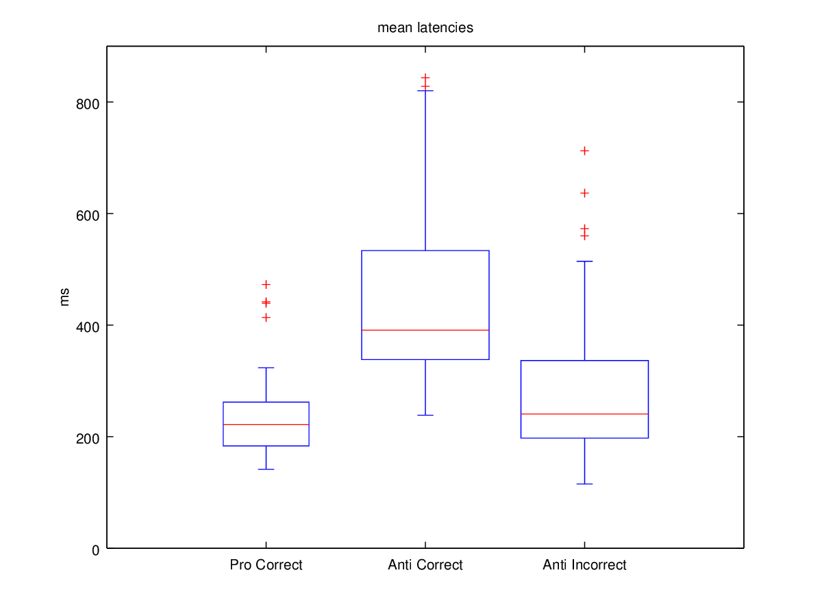
Towards a multi-process model of antisaccades in PD
Again consistent with recent ‘Discovery’ study:
Mean saccadic latency (ms)
800
600
400
200
0
Correct
PS trials
Correct
AS trials
Incorrect
AS trials

Slide 10
Towards a multi-process model of antisaccades in PD
Part II: The basal ganglia and the antisaccade network

Slide 11

Towards a multi-process model of antisaccades in PD
The basal ganglia + saccades:
‘Deciding where to look’ is Action Selection Problem
Basal ganglia involved in action selection via disinhibition of targets
Connected with Frontal eye fields and superior colliculus
Known to be involved in selection of eye movements
(Hikosaka et al., 2000; 2006)
PD is disorder of basal ganglia function - indicates importance in AS task

Slide 12
Towards a multi-process model of antisaccades in PD
Cognitive and motor processes for antisaccades:
Simple prosaccades are reflexive
Antisaccades require two ‘top down’ processes:
Inhibition of reflexive prosaccade
Generation of ‘anti’ saccade co-ordinates and motor command
… so slower and more error prone!
Automatic stimulus-response: ‘look here’
Controlled goal-directed response: 1) ‘Don’t look here’
2) ‘Look there’

Slide 13
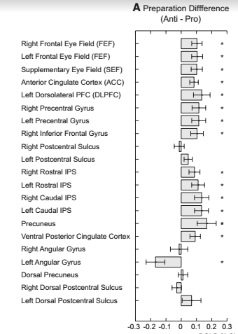
Towards a multi-process model of antisaccades in PD
Underlying neural mechanisms:
Prosaccades: Oculomotor control
Frontal eye fields, superior colliculus
But…
Antisaccades: Oculomotor control + inhibition of saccade + remapping of saccade
Frontal eye fields, superior colliculus
Prefrontal cortex, parietal eye fields – especially prestimulus
‘Antisaccade network’
Brown et al., 2007

Slide 14
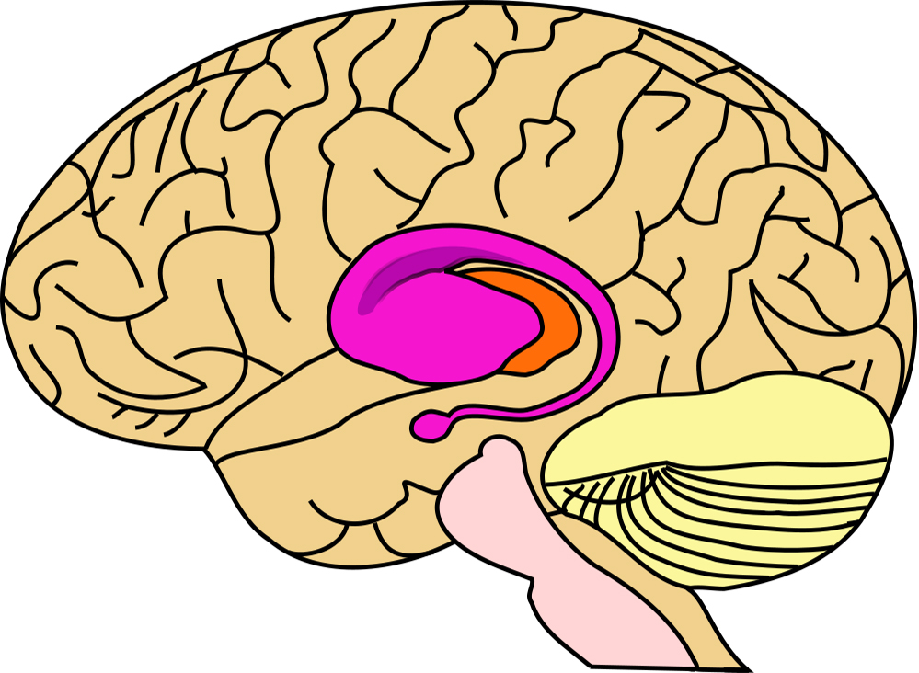
Towards a multi-process model of antisaccades in PD
Basal ganglia and the antisaccade network:
Frontal eye fields, superior colliculus, prefrontal cortex and parietal eye fields ALL in loops with basal ganglia:
FEF
PEF
PFC
SC

Slide 15
Towards a multi-process model of antisaccades in PD
Significance of basal ganglia:
PFC – BG loop
SEF – BG loop
FEF – BG
loop
PEF – BG
loop
Task rules and context in WM?
Specifying saccades?
Oculomotor execution
Visual attention and programming saccade?
Need to model sub-processes in response inhibition and voluntary saccade generation independently in BG-cortical loops to account for antisaccade performance

Slide 16
Towards a multi-process model of antisaccades in PD
Part III: Existing basal ganglia model of antisaccades

Slide 17
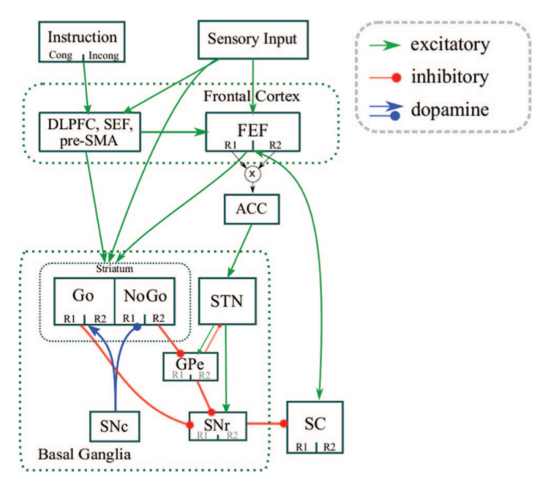
Towards a multi-process model of antisaccades in PD
Modelling antisaccades with BG: existing work
Wiecki & Frank, 2015
3 mechanisms for antisaccades
‘Hold your horses’ signal in hyperdirect pathway – raises selection threshold
Excitation of stimulus location response in ‘No-go’ pathway
Excitation of opposite location response in ‘Go’ pathway

Slide 18
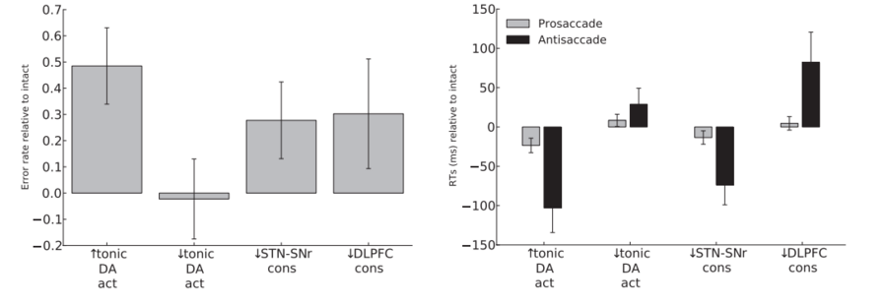
Towards a multi-process model of antisaccades in PD
Modelling depleted DA in motor BG:
Change in AS error rate
Change in saccadic latency
Model cannot account for PD antisaccade data by depleting tonic DA in motor regions of BG

Slide 19
Towards a multi-process model of antisaccades in PD
Problems
PD usually results in motor deficits, including action slowing
But prosaccade RTs spared in PD – sometimes faster!
Antisaccades are ‘cognitive’, not ‘motor’…
Usually reflexive behaviour affected, goal-directed behaviour spared
But reverse pattern for antisaccade tasks?
New proposal
Some compensatory mechanism preserves prosaccades
Results in false impression of goal-directed impairment

Slide 20
Towards a multi-process model of antisaccades in PD
Cope et al., (submitted for publication)
Existing precedent for compensatory mechanism…

Slide 21
Towards a multi-process model of antisaccades in PD
Cope et al., (submitted for publication)
…Relative strengthening of subcortical loop speeds prosaccades, accounting for express saccades

Slide 22
Towards a multi-process model of antisaccades in PD
Part IV: A new approach to modelling antisaccades in Parkinson’s

Slide 23
Towards a multi-process model of antisaccades in PD
Hypothesis
Subcortical loop strengthened in PD
Compensatory mechanism to spare reflexive saccades
Will result in higher error rate in antisaccade task
Because prosaccades will be executed before antisaccade command reaches sufficient levels of activity to compete
Will result in slower antisaccades
Higher activation of prosaccade command will cause greater competition, slowing antisaccade RTs on successful trials
In severe PD, DA loss worsens and spreads to associative BG (PEF)
Further slowing antisaccades and increasing error rate

Slide 24
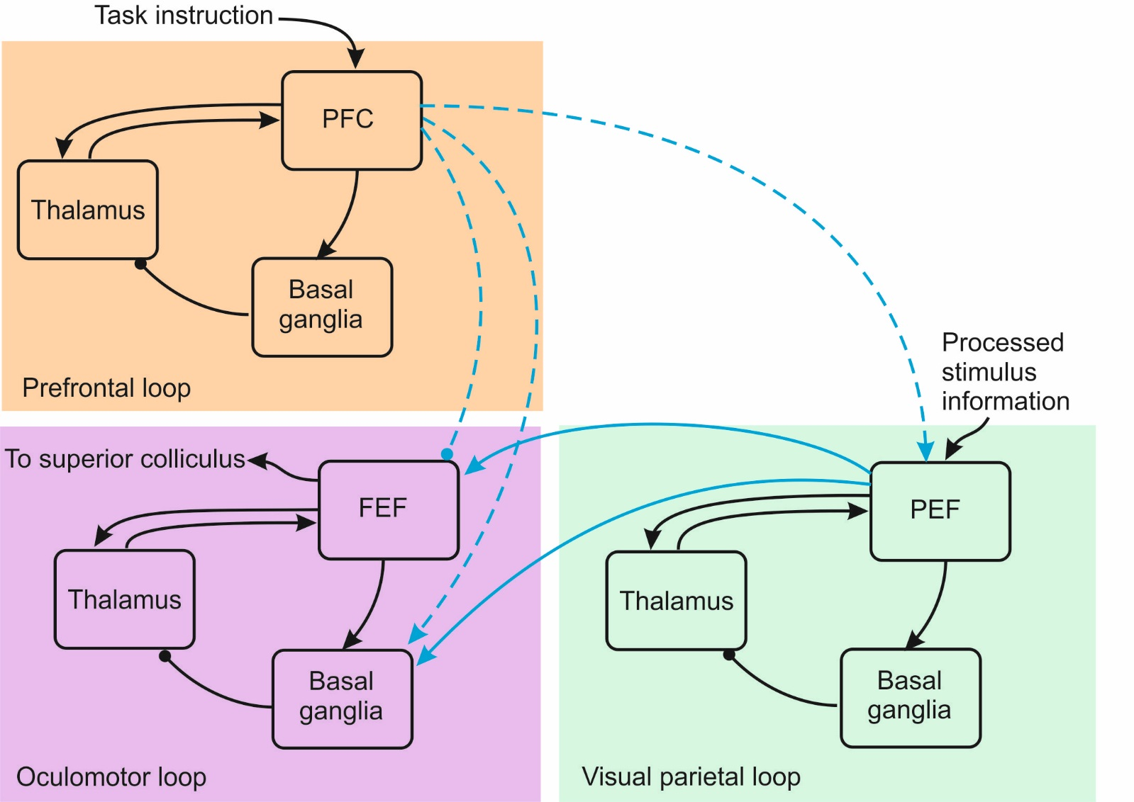
Towards a multi-process model of antisaccades in PD
New model architecture:
Multiple basal ganglia loops
Oculomotor loop is Cope et al model
PFC: Selection of task context
PEF: Selection of antisaccade co-ords
FEF: Oculomotor: saccade selection

Slide 25
Towards a multi-process model of antisaccades in PD
New model architecture:
Healthy model
Similar to Wiecki & Frank model
Antisaccades require selection of task context
‘Presets’ antisaccade command selection in PEF
Noisy: distraction results in failure on some trials

Slide 26
Towards a multi-process model of antisaccades in PD
New model architecture:
Early PD
Deplete DA in oculomotor loop
Prosaccades preserved by strong SC loop
Errors now result from two mechanisms

Slide 27
Towards a multi-process model of antisaccades in PD
New model architecture:
Late PD
Prosaccades still preserved by strong SC loop
DA loss spreads to PEF loop
Errors now result from three mechanisms

Slide 28
Towards a multi-process model of antisaccades in PD
Part V: Exciting model results!

Slide 29
Towards a multi-process model of antisaccades in PD
Model results:
Error rates (%)
Saccade latencies (ms)
From data in Kitagawa et al., 1994

Slide 30
Towards a multi-process model of antisaccades in PD
Compare Kitagawa (1994) data:
Error rates (%)
Saccade latencies (ms)

Slide 31
Towards a multi-process model of antisaccades in PD
Error prosaccades consistent with Walton (2015) data:
Saccade latencies (ms)
Saccade latencies (ms)

Slide 32
Towards a multi-process model of antisaccades in PD
Depleting DA without compensation doesn’t work!
Error rates (%)
Saccade latencies (ms)

Slide 33
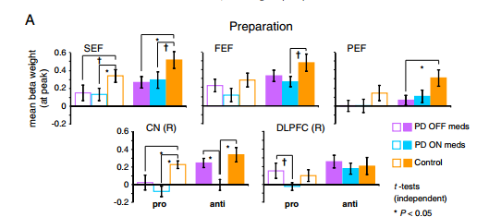
Towards a multi-process model of antisaccades in PD
Summary of results
No slowing of prosaccades in PD
Slowing of antisaccades in early PD, more in late PD
Early PD shows higher error rate than control
Late PD shows higher error rate than early PD
Error prosaccades are faster than antisaccades
BONUS: Activation profiles consistent with imaging data:
No difference between PD and controls in PFC BOLD signal
PD show lower parietal BOLD signal on antisaccades than controls
Cameron et al., 2012

